Slide 1
LEARN HTML
1

Slide 2
HTML Introduction:
What is HTML?

Slide 3
It stands for Hyper Text Markup Language.
HTML is a markup Language.
Markup Language is a set of Markup tags.
HTML document contains HTML tags and a plain text.
HTML document is called webpages.

Slide 4
What is HTML tags?
It is a keywords surrounded by angle brackets like <html>.
It comes in pairs like <html> </html>.
<html>
Start tag/Opening tag
</html>
End tag/Closing tag

Slide 5
HTML Basic code will look like:
<html>
<head>
<title> My First Website </title>
</head>
<body>
<h1> My First Heading </h1>
<p> My First Paragraph </p>
</body>
</html>

Slide 6
HTML Editor:
There are many application to edit HTML like:
Adobe Dreamweaver,
Coffecup HTML Editor,
Notepad++,
Notepad,
Sublime Text etc.
Note: I recommend my student to use Sublime Text

Slide 7
Are you ready to edit some basic HTML codes?
Open Sublime Text?
Step 1 : Press Start menu
Step 2 : All Programs
Step 3 : Search “Sublime Text”
Step 4: Click Right Button

Slide 8
Type as it is in your editor:
<html>
<head>
<title> My First Website </title>
<head>
<body>
<h1> My First Heading </h2>
<p> My First Paragraph </p>
</body>
</html

Slide 9
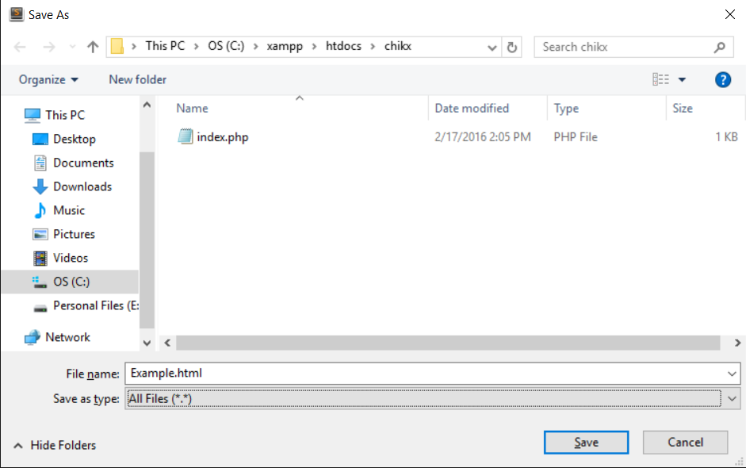
Save your file:
Use .htm or .html file extension.

